Slide 1
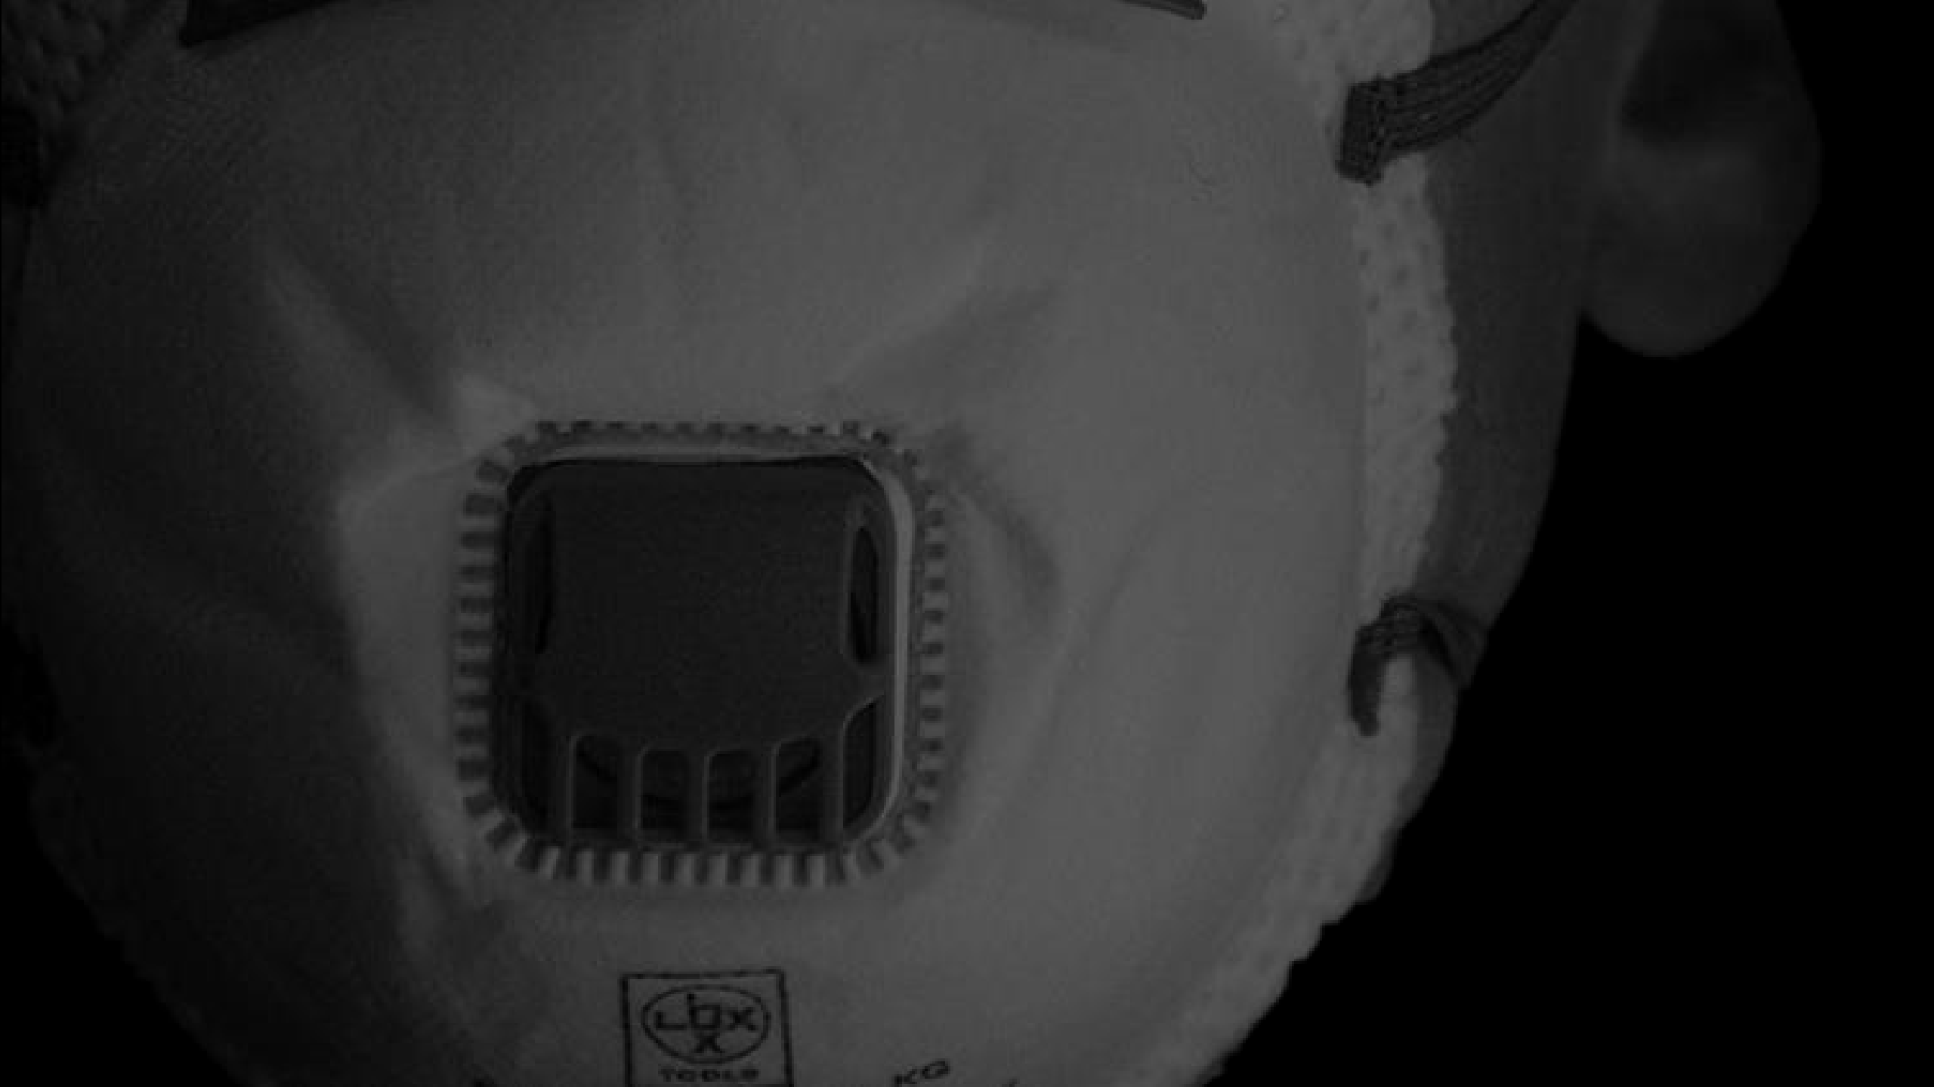
FACE MASK DETECTION-A CONVOLUTIONAL
NEURAL NETWORK(CNN) PROJECT
PRESENTED BY AGILAN A
3 YEAR CSE DEPT
This Photo by Unknow n author is licensed under CC BY-NC.

Slide 2
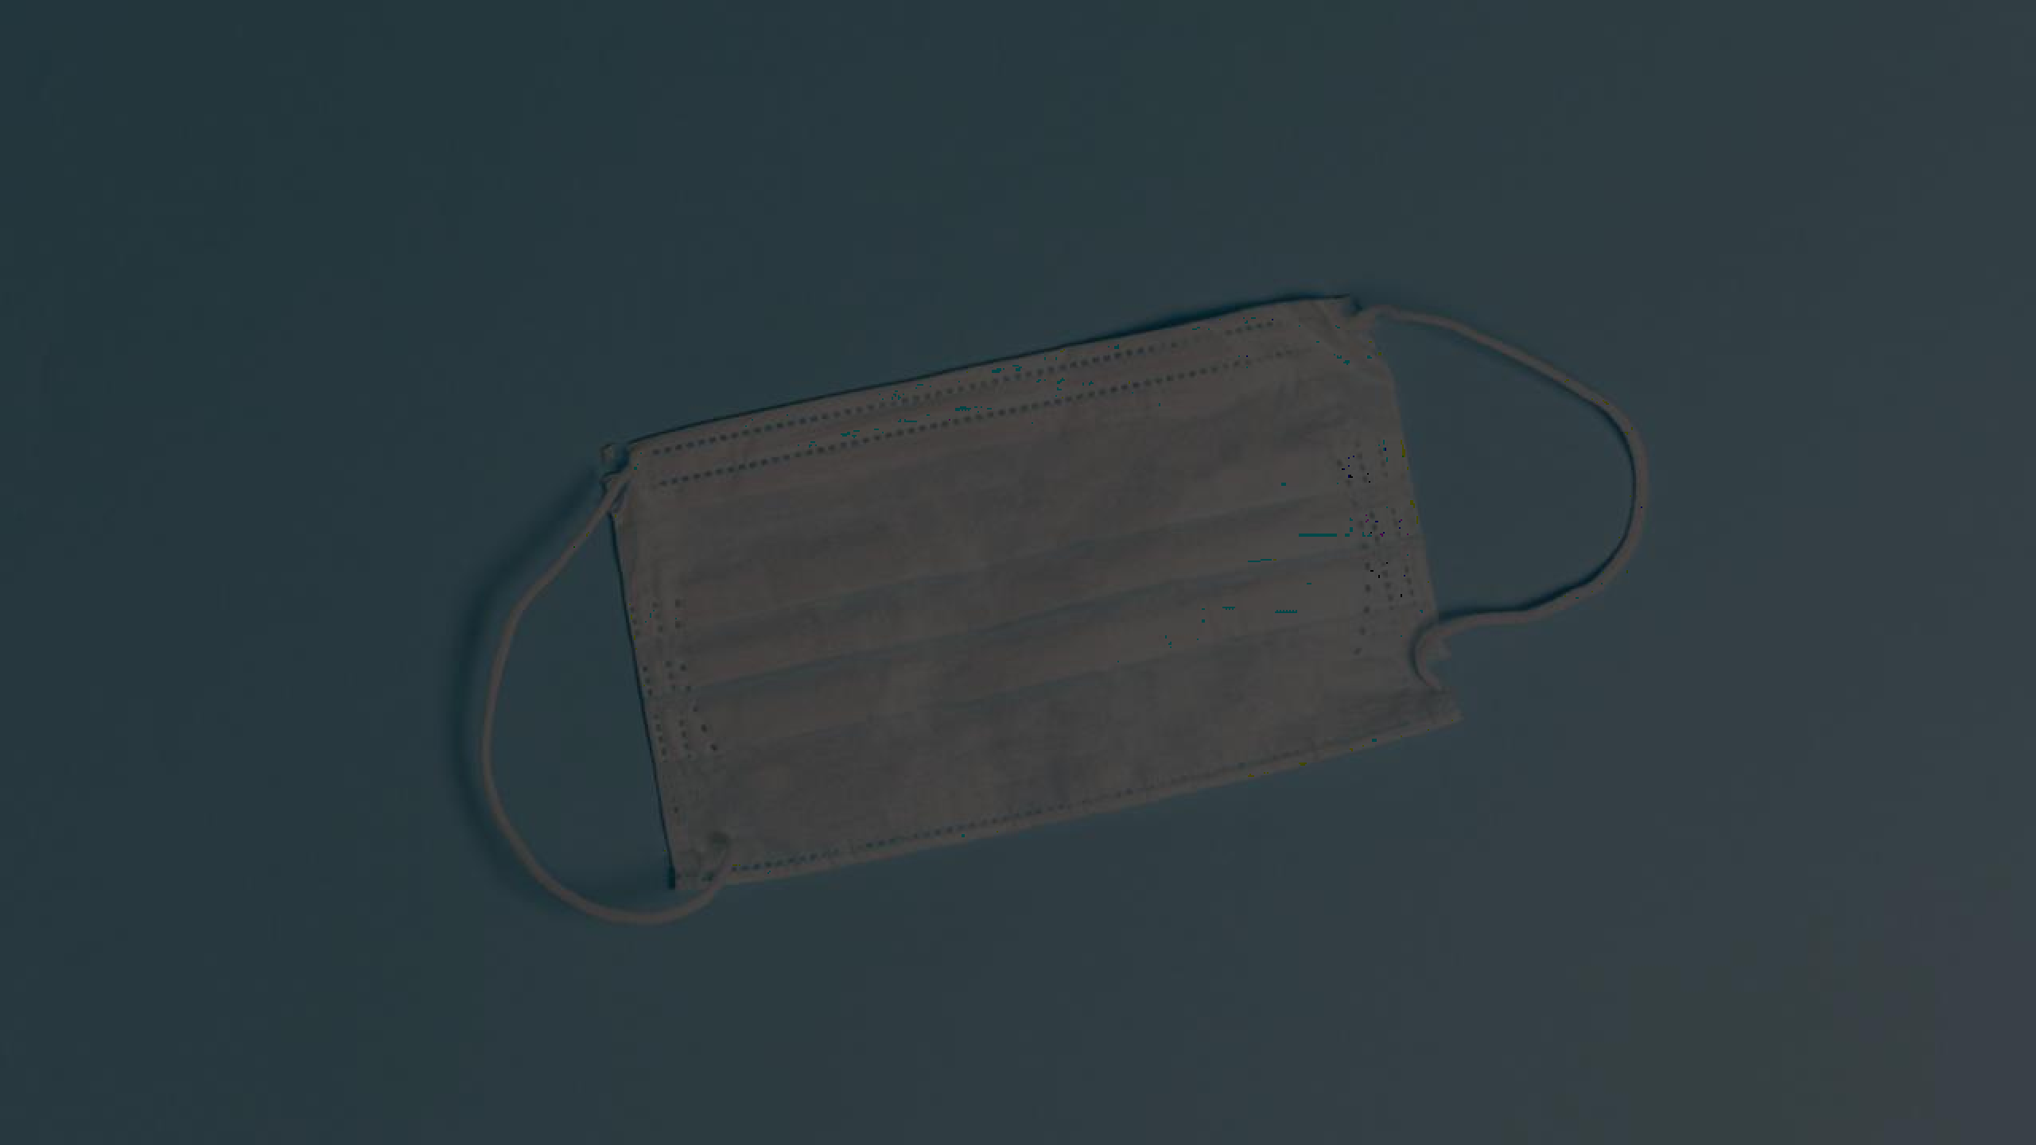
AGENDA
Introduction
Problem Statement
Proposed System/Solution
System Development Approach
Algorithm and Deployment
Result
Conclusion
Reference

Slide 3
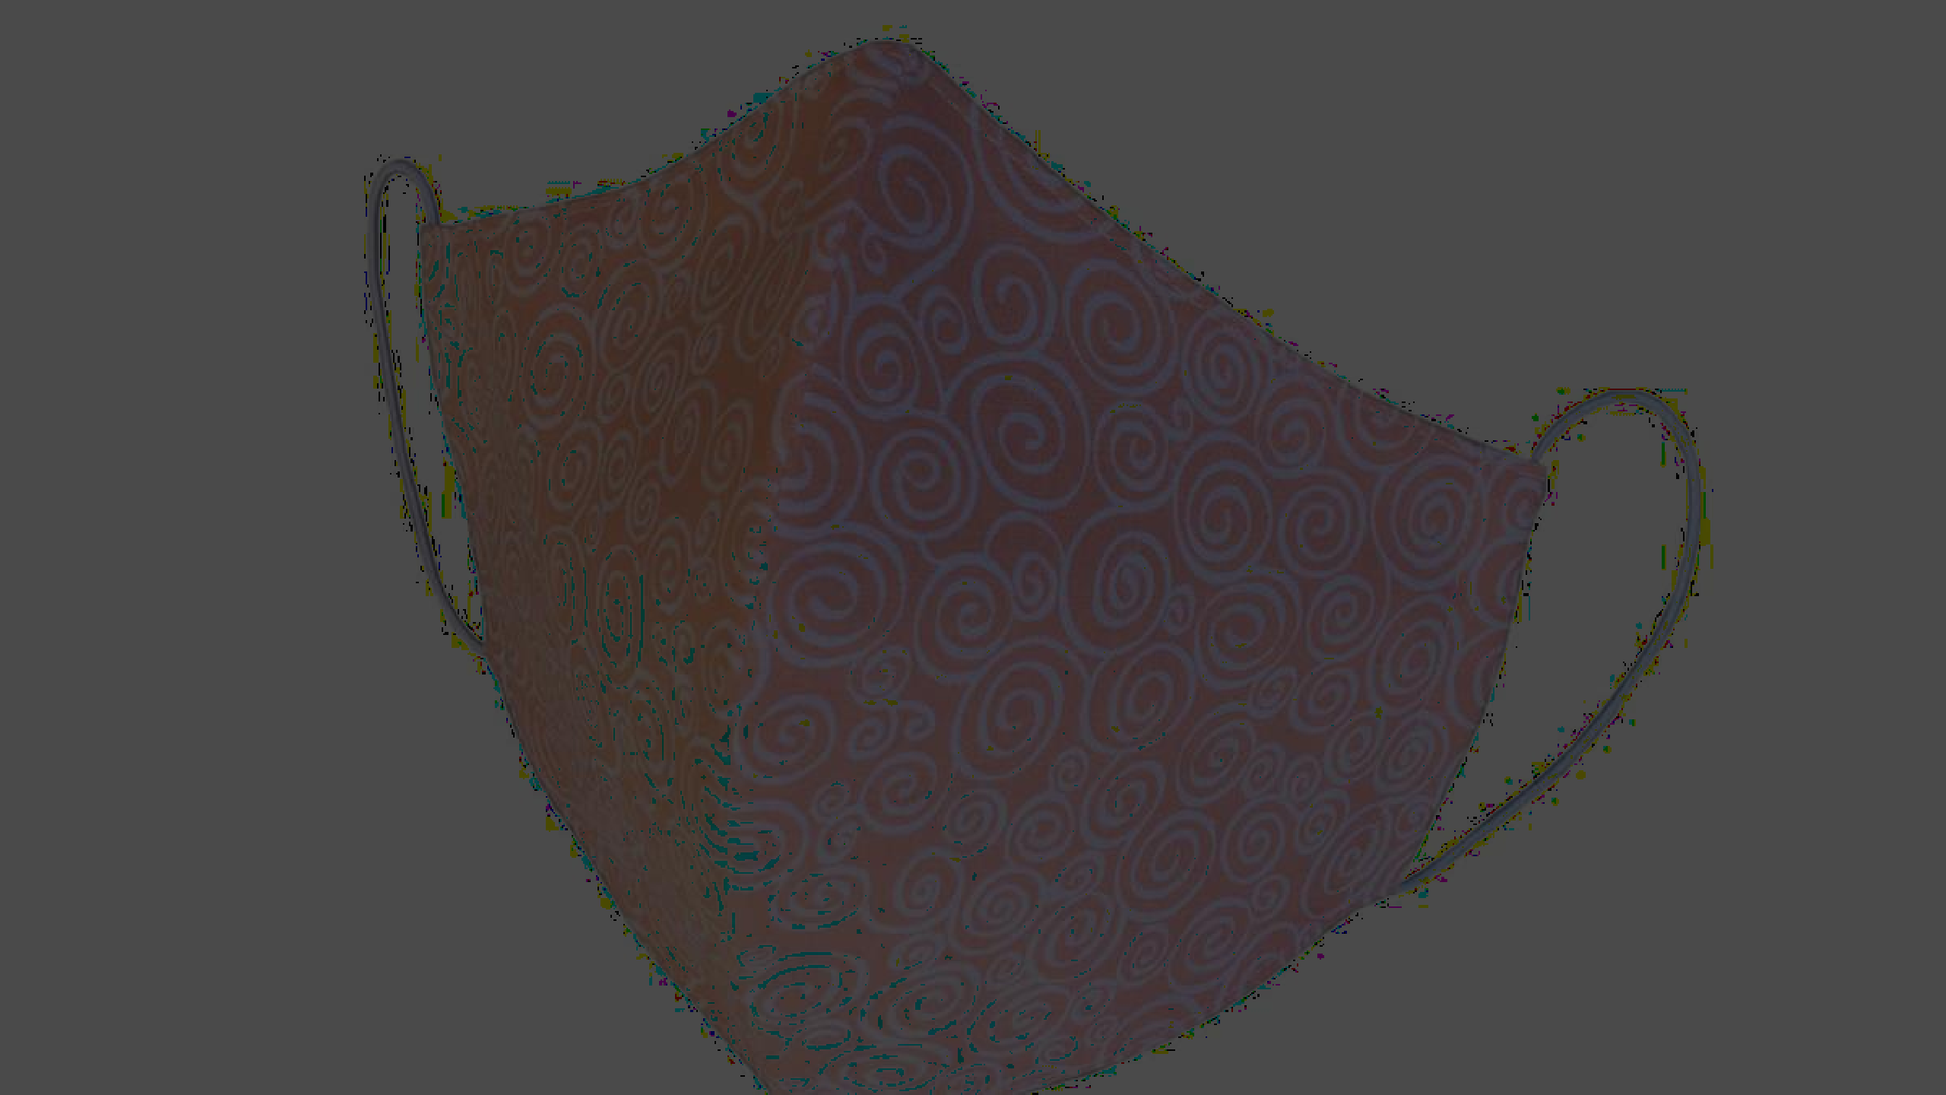
INTRODUCTION
•In the realm of computer vision, face mask detection has emerged as a critical application. The goal is to determine whether an individual is wearing a face mask or not. We frame this task as a binary classification problem, where the model categorizes images into two classes: “with mask” or
“without mask.”
•The COVID-19 pandemic underscored the importance of preventive
measures, including mask-wearing. However, human error often leads to incorrect mask usage—such as not covering the nose or mouth—which renders the
mask ineffective. To address this, deep learning techniques, particularly CNNs, have been employed to detect masked faces effectively.
This Photo by Unknow n author is licensed under CC BY-SA.

Slide 4
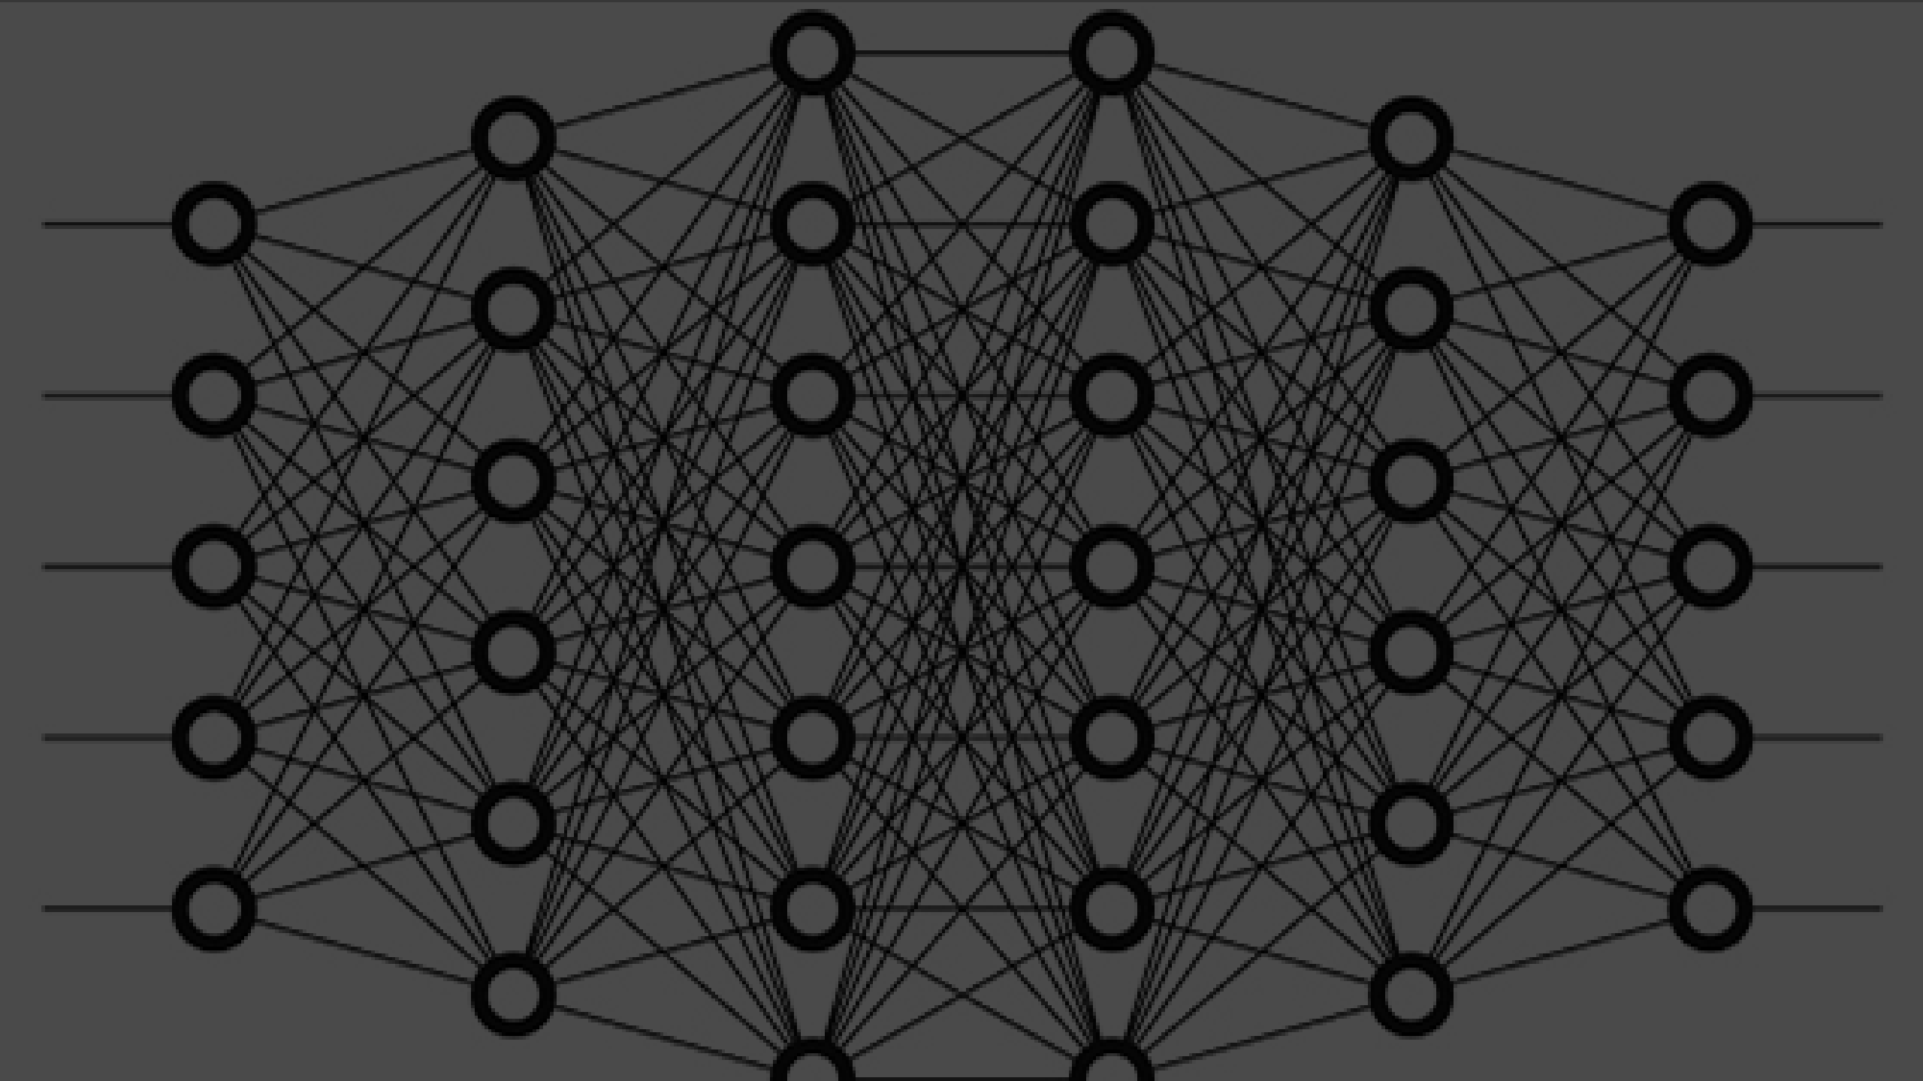
PROBLEM STATEMENT
•The goal is to differentiate between images of people with and without masks.
•A Convolutional Neural Network (CNN) is employed for this task.
•The CNN achieves an impressive 98.2% accuracy on the training set and 97.3% accuracy on the test set.
•The trained model’s weights are then used to classify whether a person is
wearing a mask or not in real time using OpenCV.
•The model works efficiently with no noticeable lag time between wearing/removing a mask and displaying predictions.

Slide 5

PROPOSED SYSTEM/ SOLUTION
Binary Classification:
The most straightforward approach is binary classification:
Class 1: Represents faces with masks.
Class 0: Represents faces without masks.
CNNs learn to distinguish between these two classes based on image features.

Slide 6

SYSTEM DEVELOPMENT APPROACH
Hardware Requirements:
Webcam:
A functional webcam is necessary for capturing real-time video streams.
Ensure your system has a working webcam.
System Resources:
At least 4 GB RAM (more is preferable) for smooth execution.
Adequate storage space (e.g., 1TB hard disk).
A 64-bit processor (e.g., Intel Core i5 or equivalent).
Operating System:
The software components mentioned above are compatible with various operating systems (Windows, Linux, macOS).
Power Supply:
1.Ensure a stable power supply to avoid interruptions during model training or inference.

Slide 7
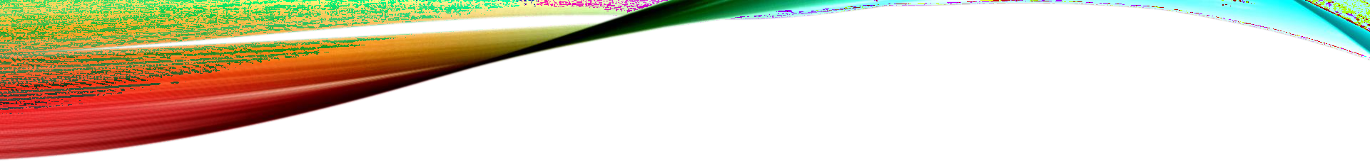
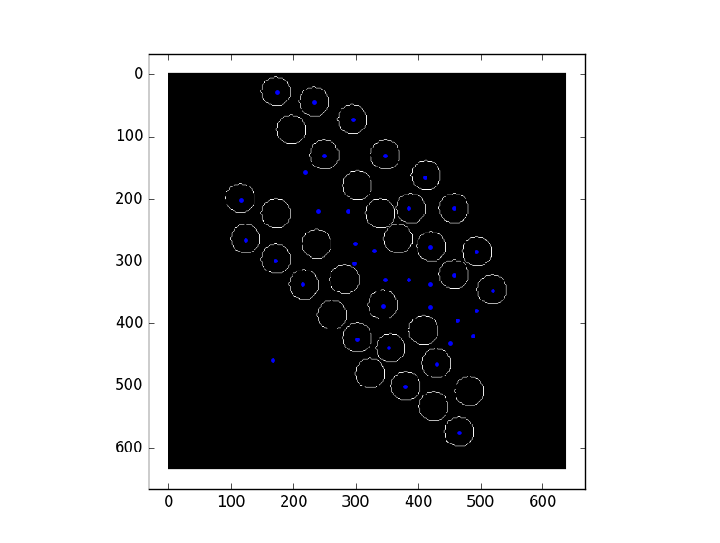
SYSTEM DEVELOPMENT APPROACH (CONT.)
Software Requirements:
Python (version 3.x):
Python is essential for implementing the face mask detection model.
Install Python on your system.
OpenCV (version 4.4.0 or higher):
OpenCV provides tools for image processing, computer vision, and real-time video analysis.
Install OpenCV using pip install opencv-python.
NumPy (version 1.19.3 or compatible):
NumPy is used for numerical computations and array manipulation.
Install NumPy using pip install numpy.
TensorFlow (version 2.5.0 or compatible):
TensorFlow is a deep learning framework.
This Photo by Unknow n author is licensed under CC BY-SA.
Install TensorFlow using pip install tensorflow.

Slide 8

SYSTEM DEVELOPMENT APPROACH (CONT.)
Software Requirements(Cont.):
Scikit-learn (version 0.24.2 or compatible):
Scikit-learn prov ides machine learning tools.
Install Scikit-learn using pip install scikit-learn.
MediaPipe (v ersion 0.8.5 or compatible):
MediaPipe offers solutions for face detection and other computer v ision tasks.
Install MediaPipe using pip install mediapipe.
Tqdm (v ersion 4.60.0 or compatible):
Tqdm prov ides progress bars for loops and tasks.
Install Tqdm using pip install tqdm.
Google Colab: These platforms can be used for interactiv e development, experimentation, and documentation.
These requirements will help you set up a system capable of running a face mask detection project using CNN binary
classification.
This Photo by Unknow n author is licensed under CC BY-SA.

Slide 9
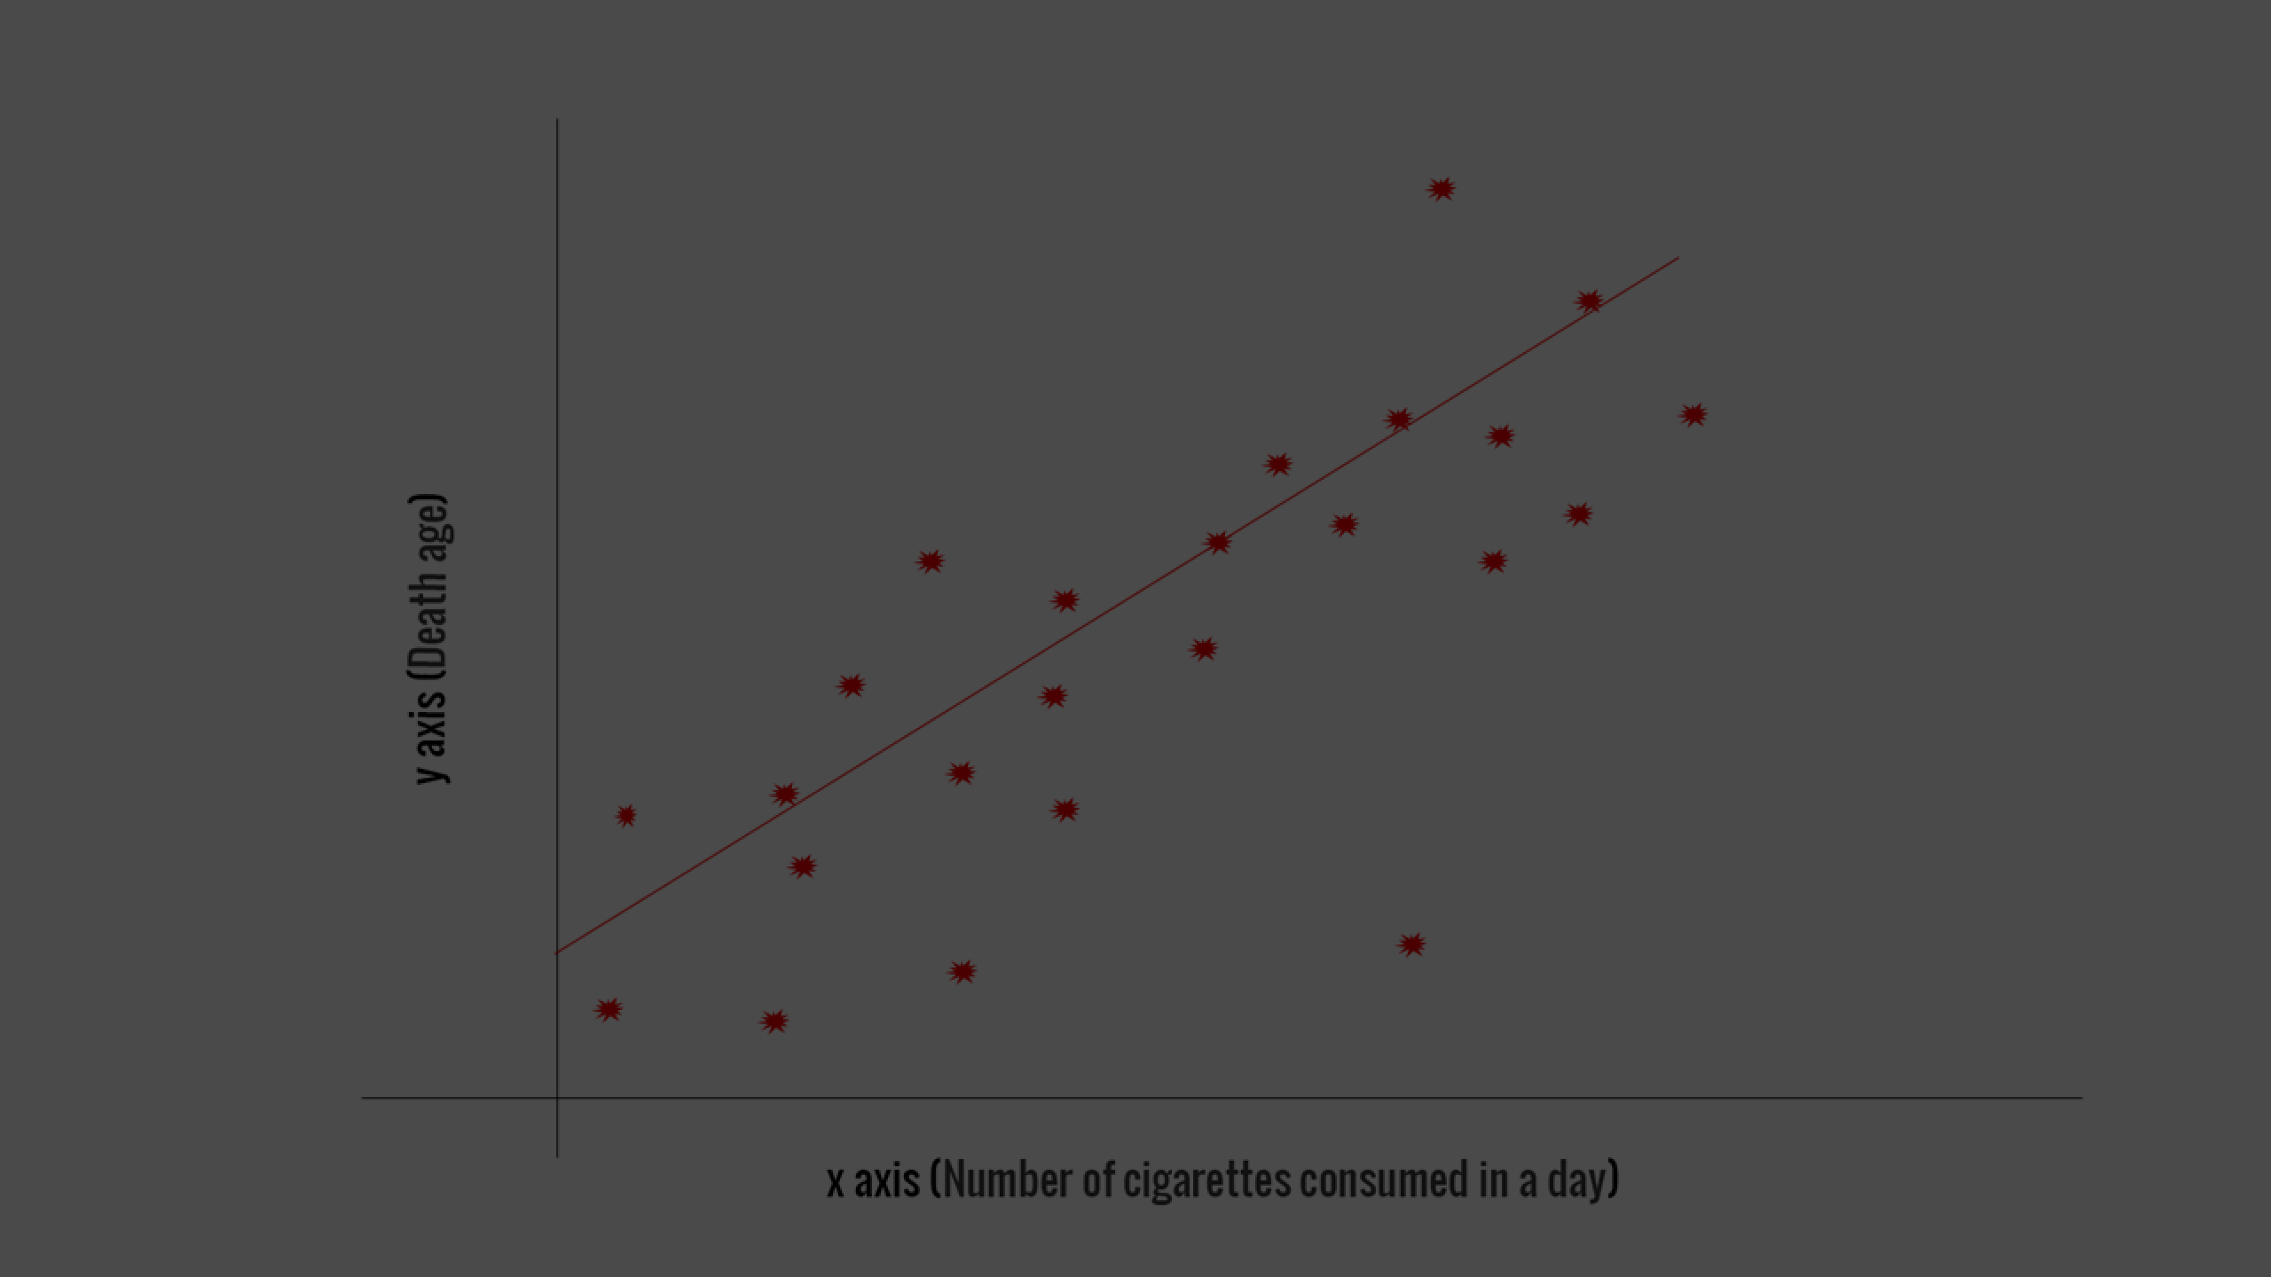
5.ALGORITHM AND DEPLOYMENT
Importing Face mask Dataset
Fetch the Dataset:
You are using the Kaggle API to download the face mask dataset.
Extract the Compressed Dataset:
The downloaded dataset is in a compressed format (ZIP).
You extract the contents of the ZIP file using Python.
Importing the Dependencies
List Files:
The code lists files in two directories: with_mask and without_mask.
These directories contain face images with and without masks.
Count Images:
It calculates the total number of images in each category.
Helpful for dataset understanding.
This Photo by Unknow n author is licensed under CC BY.

Slide 10

Creating Labels for the two class of Images:
with mask --> 1
without mask --> 0
.Image Processing :
Resize the Images.
Convert the images to NumPy arrays.
ALGORITHM AND DEPLOYMENT (CONT.)
Train Test Split.
Building a Convolutional Neural Networks (CNN).
Model Evaluation.
Building a Predictive System.

Slide 11

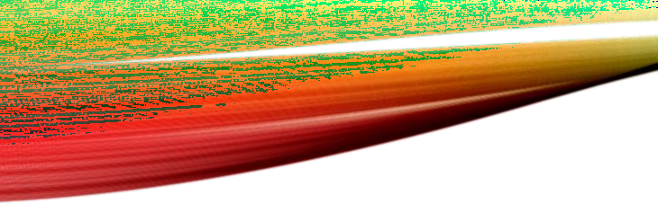
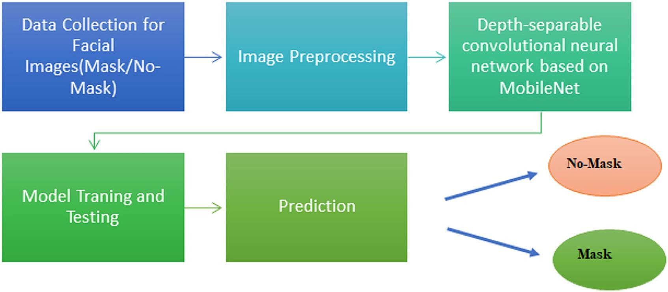

FLOW CHART

Slide 12
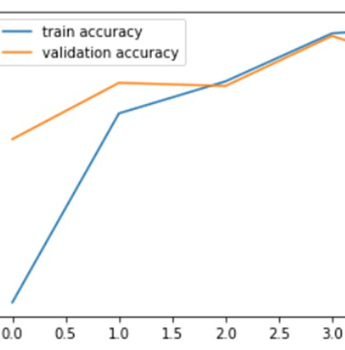
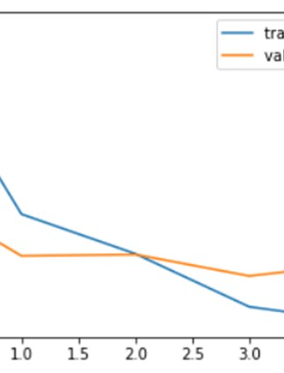
RESULT

Slide 13
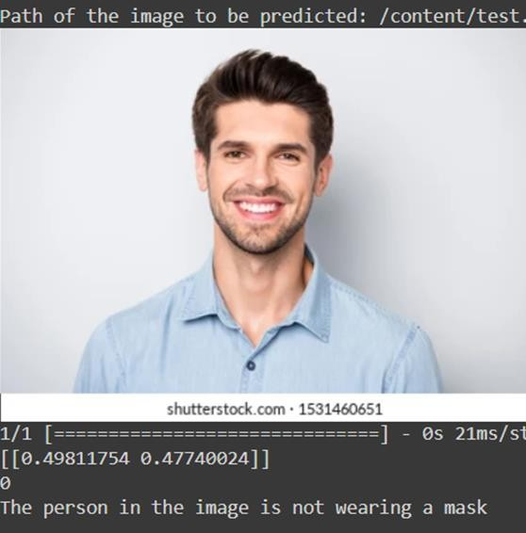
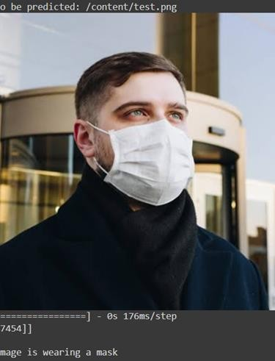
RESULT(CONT.)

Slide 14
CONCLUSION
Developing a custom convolutional neural network (CNN) for face mask detection is crucial for public health
efforts. Trained on 12,000 mask images, the model achieved impressive accuracy during both training and testing. Its exceptional precision, recall, and F1 score contribute significantly to disease prevention, particularly during the COVID-19 pandemic.

Slide 15
REFERENCE
•https://www.python.org/
•https://www.tensorflow.org/
•https://keras.io/
•https://numpy.org/
•https://matplotlib.org/
•https://scikit-learn.org/
•https://opencv.org/
•https://www.kaggle.com/datasets/omkargurav/face-mask-dataset

